Slide 1
Writing a formal letter
letter of protest

Slide 2
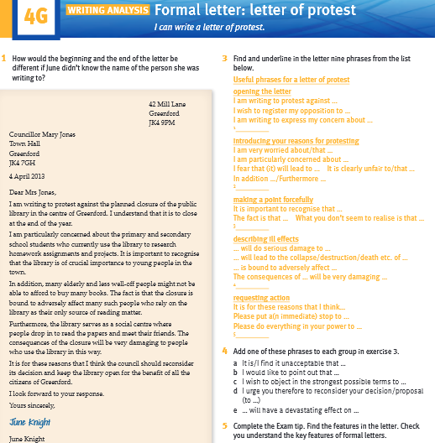
For today's class you will need student's book: Solutions Upper-intermediate, pages 44-45

Slide 3
Formal letter
Think of a situation that would make you protest (e.g. the school principal decided to forbid gatherings in the schoolyard during the breaks)
How would you start your letter?
What would you write to make a strong point?
How would you describe negative effects?
How would you end your letter?

Slide 4
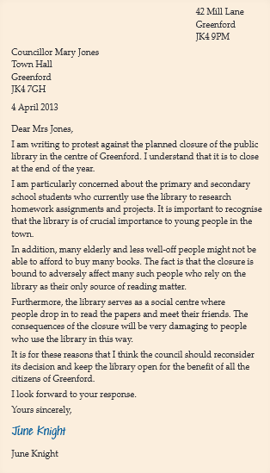
Example of a formal letter
read the letter on page 44 in your student's book
How do we start and end the letter if we do not know the name of the person we are writing to? (page 44, task 1)

Slide 5
Now answer the questions. (page 44, task 2)
What is the council planning to do, and when?
How many objections does June raise in her letter?
​ How do many students currently use the library?​
How will the closure affect elderly and less affluent people?​
How else do people use the library, apart from to borrow books?
What action does June request?

Slide 6
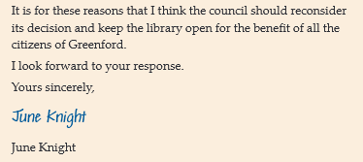
Find and underline in the letter nine phrases from the list below (page 44, task 3)
Useful phrases for a letter of protest
opening the letter​
I am writing to protest against …​
I wish to register my opposition to …​
I am writing to express my concern about …
introducing your reasons for protesting​
I am very worried about/that …​
I am particularly concerned about …​
I fear that (it) will lead to … It is clearly unfair to/that …​
In addition …/Furthermore …
making a point forcefully​
It is important to recognise that …​
The fact is that …
What you don’t seem to realise is that …
describing ill effects​
… will do serious damage to …​
… will lead to the collapse/destruction/death etc. of …​
… is bound to adversely affect …​
The consequences of … will be very damaging …
requesting action​
It is for these reasons that I think…​
Please put a(n immediate) stop to …​
Please do everything in your power to …

Slide 7
Add one of these phrases to each group in exercise 3 (page 44, task 4)
a It is/I find it unacceptable that …
b I would like to point out that …
c I wish to object in the strongest possible terms to …
d I urge you therefore to reconsider your decision/proposal (to …)
e … will have a devastating effect on …
1 opening the letter __________
2 introducing your reasons for protesting _____________
3 making a point forcefully ____________
4 describing ill effects ____________
5 requesting action _________

Slide 8
Complete the Exam tip. Find the features in the letter. Check you understand the key features of formal letters
EXAM TIP
Put __________at the top on the right, __________ address just below on the left and __________ below that.
Start and end the letter correctly: Dear __________ or Madam / name … Yours faithfully / __________.
Avoid __________ language and __________ , direct questions and __________ marks.
At the end, sign your __________ , then print it underneath.

Slide 9
Describe the photo.
Do you or your family ever shop at
out-of- town retail parks?
Why?/Why not?
(page 45, task 1)

Slide 10
Read the newspaper article. Answer the questions. (page 45, task 2)
1 What does the council have to decide?
2 Who is paying for the new retail park?
3 How big will it be and how much will it cost?
4 What two possible advantages of the plans are mentioned in the text?
5 What two possible disadvantages are mentioned?

Slide 11
Read the task below. How many paragraphs will your letter have? (task 3, page 45)
Write a letter of protest (200–250 words) to Councillor Nesbit at Aylesmarsh Council. Include the following points:
State that you object to the proposal to build the new retail park.
Give two objections, with reasons.
Say what action you would like the council to take.

Slide 12
Plan and write your first paragraph, stating clearly what you are writing about (i.e. that you object to the proposal). Use phrases from task 3 on page 44 and slide 6. (task 4, page 45)
Now choose two reasons for objecting to the proposed retail park from the list below, or think of your own ideas. Expand the two ideas and make notes. (task 5, page 45)
Possible objections​
​effect on shops/loss of jobs in the town centre​
increased traffic​
destruction of a beautiful rural area​
effect on wildlife

Slide 13
Write the second and third paragraphs of your letter, using the notes you made in task 5. Use phrases from task 3 on page 44. (task 6, page 45)
Now decide what action you would like the council to take. Choose ideas from the list or think of your own. Expand the ideas and write notes. (task 7, page 45)
Possible actions
find an alternative location
abandon the proposal
hold an enquiry and consult local traders
build new shops and a car park in the town centre

Slide 14
Write the fourth paragraph of your letter, using the notes you made in task 7. Use phrases from task 3 on page 44.
CHECK YOUR WORK
Have you:
structured your letter following the task 3?
included some phrases in each section from page 44?​
used a polite, formal style?​
used the correct layout and language to start and​ finish your letter?​
written 200–250 words?​
checked your spelling and grammar?

Slide 15
Revision: DOs and DON’Ts when writing a formal letter
start by saying why you are writing or what you are responding to
use paragraphs to keep the letter clear and easy to understand
get to the point
keep it brief
use standard phrases
open your e-mail with informal salutations like Hi or Hello
write about irrelevant issues
use contractions, abbreviations (coz, uni)
use emoticons
use slang, profanity, jokes

Slide 17
Izvor: Solutions Upper-intermediate, OUP
Prezentaciju izradili:
Matej Kunštek, student 5 godine engleskog jezika i književnosti
Mentor: Dunja Frković, prof. savjetnik

